Slide 1



Spring Boot - Basics
Getting started with Spring Boot

Slide 2
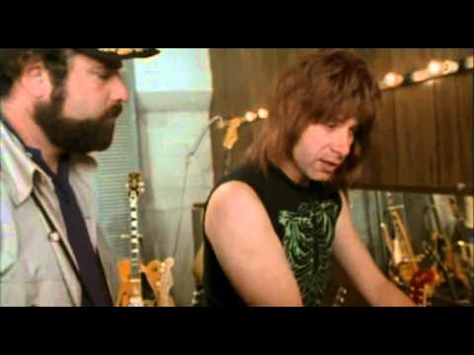
Background… Going To ‘11’
https://www.youtube.com/watch?v=4xgx4k83zzc

Slide 3

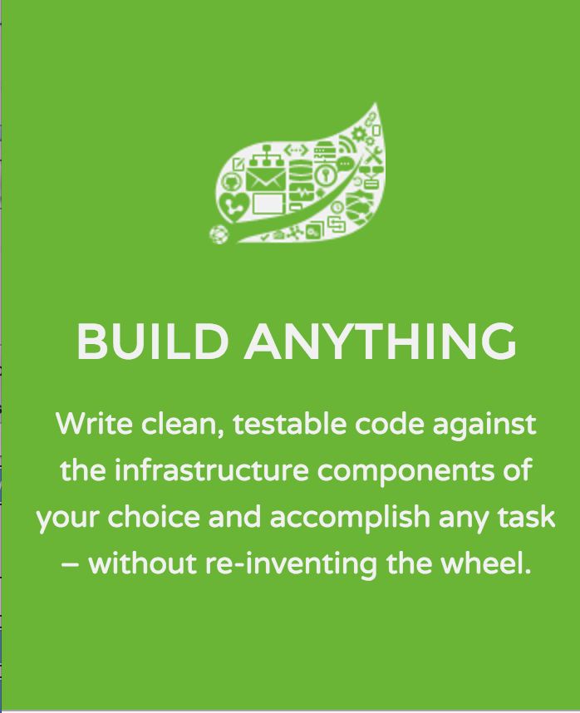
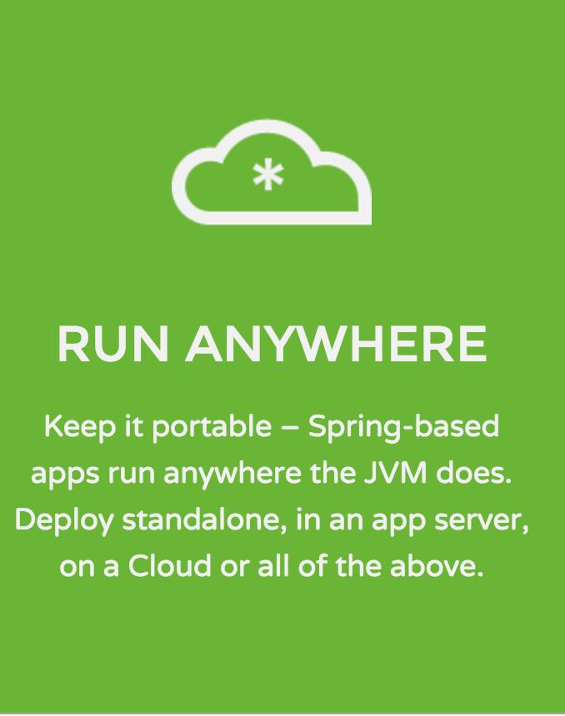
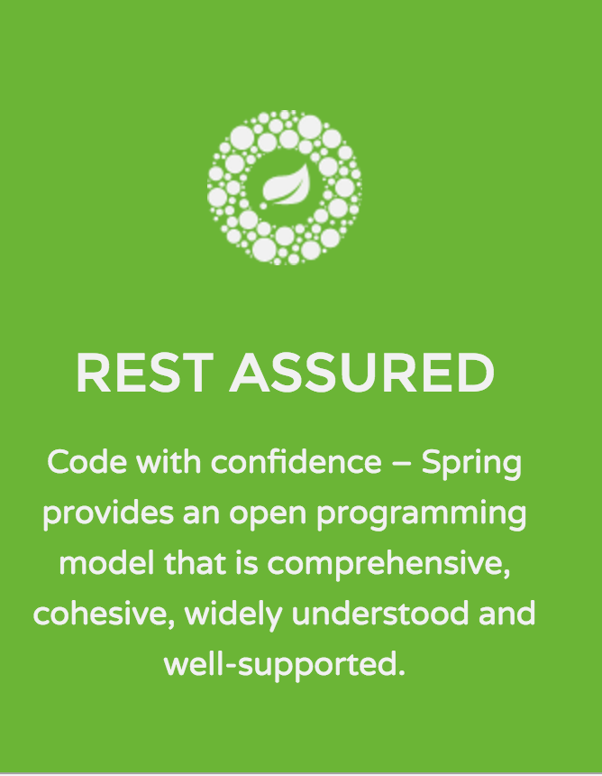
More Background: ‘Plain Vanilla’ Spring

Slide 4
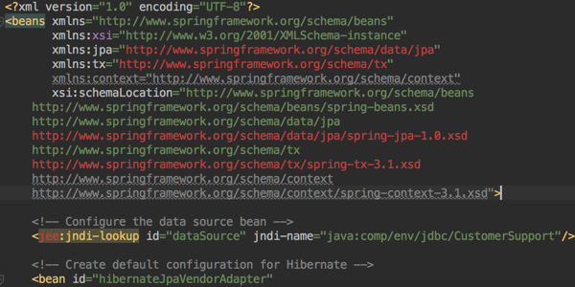
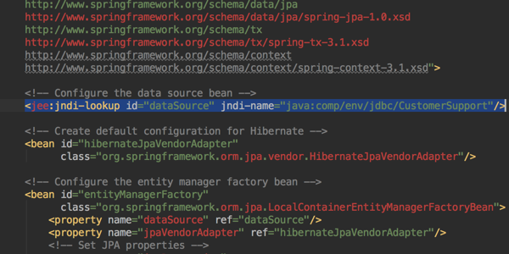
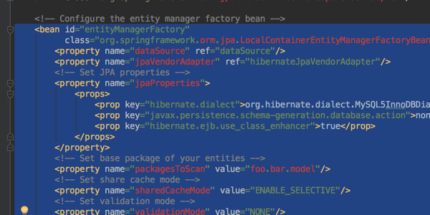
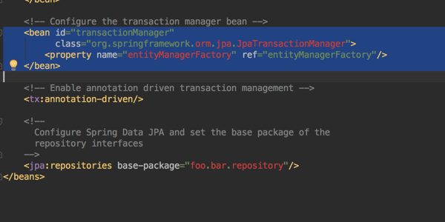
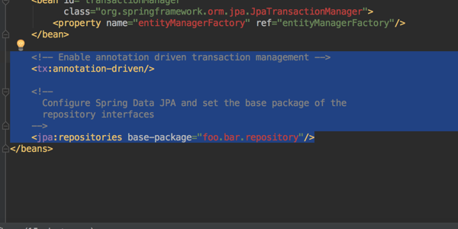
Doing things in Spring… JPA
application-context.xml
set up datasource
entity manager factory
transaction manager
Spring Data JPA

Slide 5
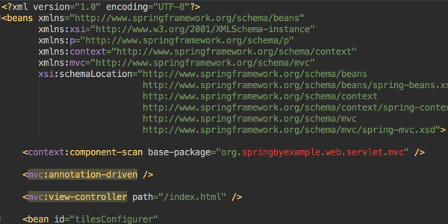
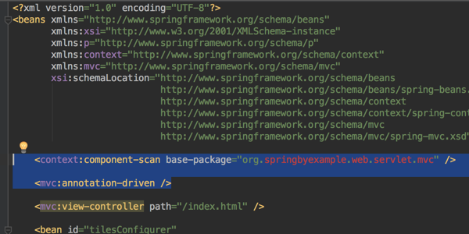
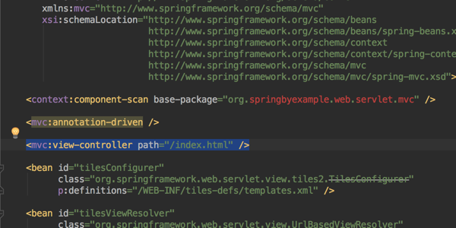
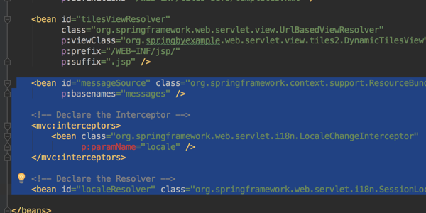
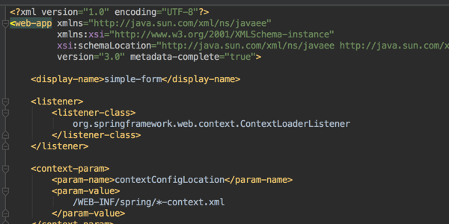
Doing things in Spring… Web MVC
application-context.xml
enable annotations
map static pages
i18n
web.xml

Slide 6
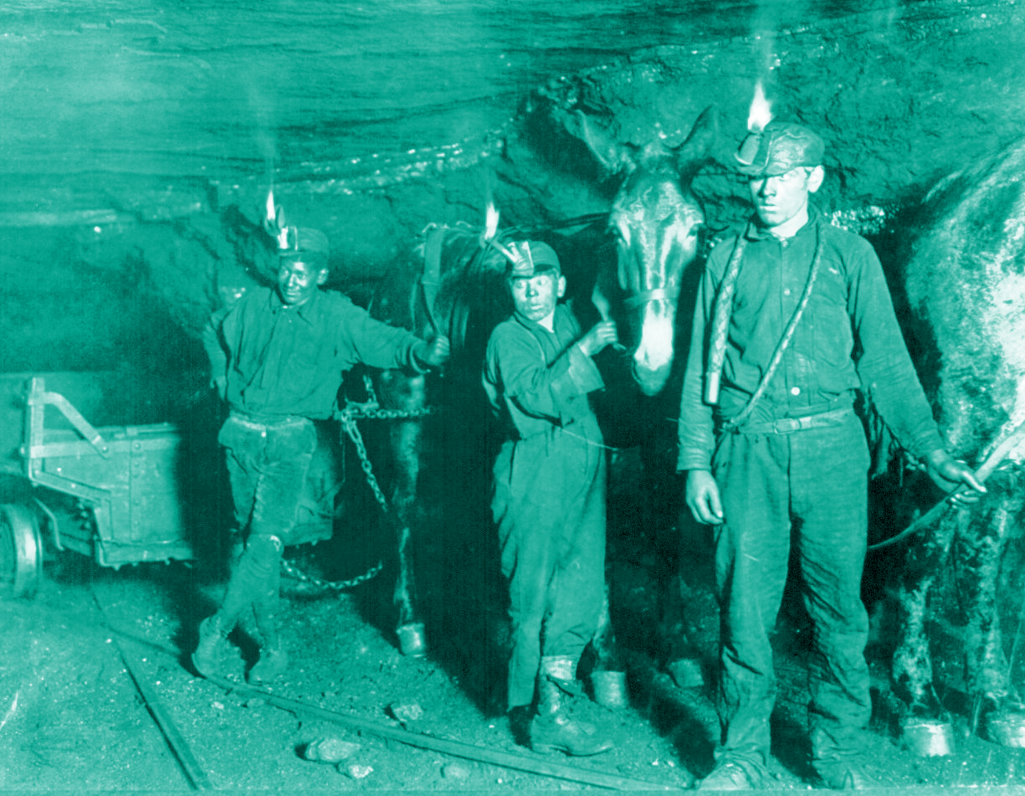
Survey
Years using Spring?
Used Spring XML-config?
Copied and pasted Java code from one Spring class to another?
Copied and pasted Java code from one Spring Project to another?
Used an existing Spring project as a starting point for a new project?

Slide 7
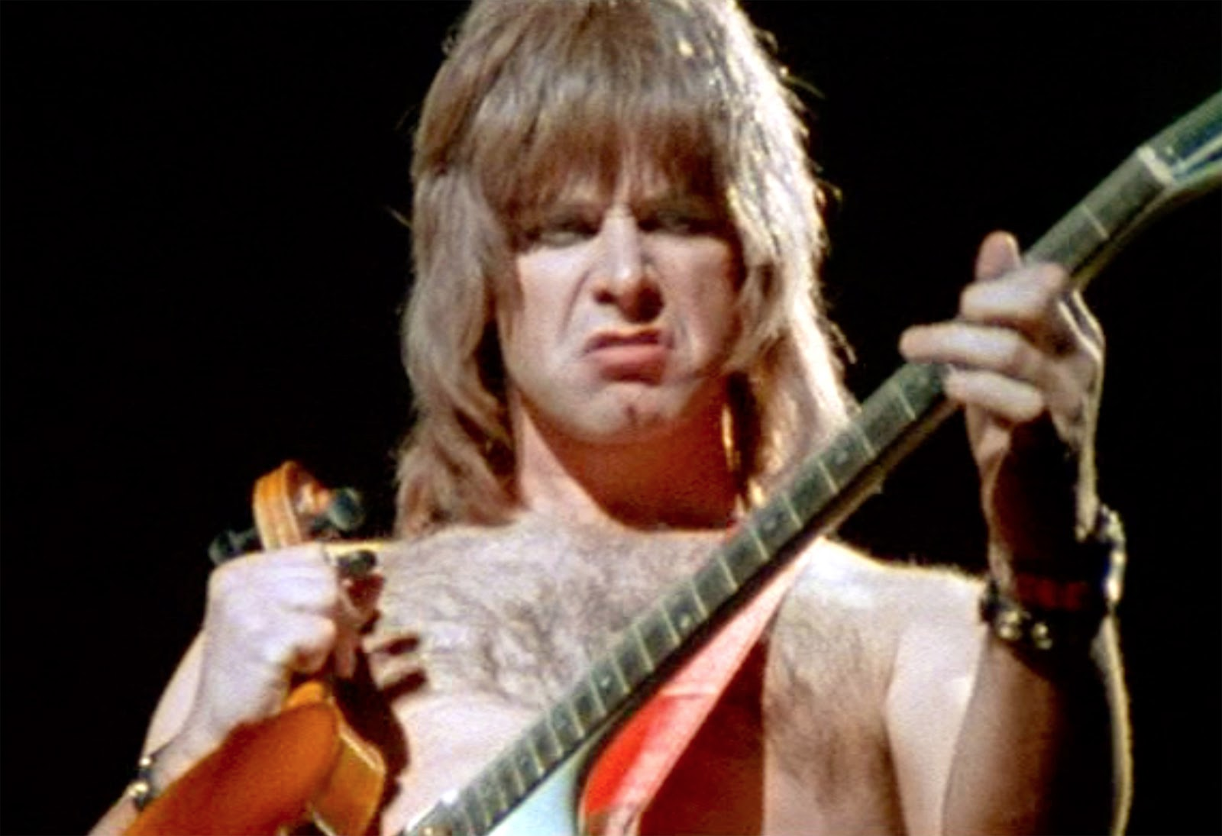

What if...
… you could turn Spring up to ‘11’
source: http://www.imdb.com/title/tt0088258/mediaviewer/rm2336406272

Slide 8
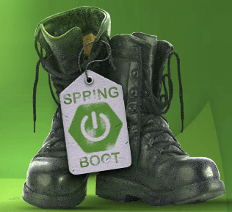
Allow me to introduce...
source: http://springframework.guru

Slide 9
Topics in this Session
What is Spring Boot?
Definition and Hello World example
Dependency Management
Ease of Use Features

Slide 10

What is Spring Boot?
Opinionated Runtime for Spring projects
Supports different project types
Web
Batch
Integration
Cloud
Sensible Defaults
Automatic Configuration

Slide 11
Opinionated Runtime? Sensible Defaults? Auto-Config?
JPA
Are the MySQL drivers on the classpath?
Let’s try to stand up a datasource!
How about Hibernate’s EntityManager?
Let’s set wire up an EMFactory to Hibernate & MySQL!
Does the app have @Entity classes?
Let’s Manage them!

Slide 12
Opinionated Runtime? Sensible Defaults? Auto-Config?
Web
Are there @Controllers and @RequestMappings?
Let’s map some routes!
What about my app server?
Don’t worry about it, Boot embeds Tomcat for you!
What about a /public, /resources, /static directory???
let Boot serve that static content for you!!

Slide 13
Hello World Example
Only 3 files needed to get a running Spring application
Setup Spring Boot dependencies (from start.spring.io)
Basic Spring MVC controller
(all you!)
Application launcher (from start.spring.io)
pom.xml
HelloController
Application class

Slide 14
Hello World – Maven Descriptor
<parent>
<groupId>org.springframework.boot</groupId>
<artifactId>spring-boot-starter-parent</artifactId>
<version>1.4.0.RELEASE</version>
</parent>
<dependencies>
<dependency>
<groupId>org.springframework.boot</groupId>
<artifactId>spring-boot-starter-web</artifactId>
</dependency>
</dependencies>
<build>
<plugins>
<plugin>
<groupId>org.springframework.boot</groupId>
<artifactId>spring-boot-maven-plugin</artifactId>
</plugin>
</plugins>
</build>
parent
Spring MVC Embedded Tomcat Jackson…
pom.xml
Notes:
Maven is just one option. You can also use Gradle or Ant/Ivy

Slide 15
Hello World – Spring MVC Controller
An RESTful controller to keep this example simple
Returns a String as the body of the HTTP Response
No view involved
@RestController
public class HelloController {
@RequestMapping(“/”)
public String hello() {
return “Greetings from Spring Boot!”;
}
}
Controller.java

Slide 16
Hello World – Application Class
@SpringBootApplication annotation enables Spring Boot
Runs Tomcat embedded
@SpringBootApplication
public class Application {
public static void main(String[] args) {
SpringApplication.run(Application.class, args);
}
}
Application.java

Slide 17
Deployment
Our “Hello World” example bundles Tomcat inside the application
Runs as an executable JAR
Spring Boot apps can also be deployed into an existing application server
As a familiar WAR file

Slide 18
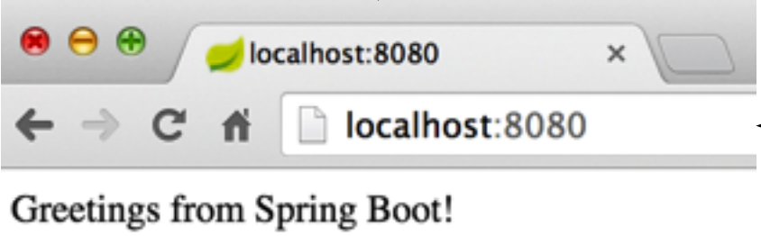
Putting it all together
Maven command to generate an archive file
mvn package
helloApp-0.0.1-SNAPSHOT.jar
Generated file
java –jar helloApp-0.0.1-SNAPSHOT.jar
App stated on command line
App runs on port 8080

Slide 19
Topics in this Session
What is Spring Boot?
Definition and Hello World example
Dependency Management
Ease of Use Features

Slide 20
How to use Spring Boot?
visit http://start.spring.io
Select your Spring Boot dependencies
Select Maven/Gradle for build management (using maven today)
Select Spring Boot version (1.4.0 today)
Give your project a name
“Generate Project”

Slide 21
Spring Boot Parent POM
Parent POM defines key versions of dependencies and Maven plugins
<parent>
<groupId>org.springframework.boot</groupId>
<artifactId>spring-boot-starter-parent</artifactId>
<version>1.4.0.RELEASE</version>
</parent>
Defines properties for dependencies, for example ${spring.version} = 4.2

Slide 22
Spring Web Dependencies
Everything you need to develop a web application with Spring
<dependencies>
<dependency>
<groupId>org.springframework.boot</groupId>
<artifactId>spring-boot-starter-web</artifactId>
</dependency>
</dependencies>
Resolves:
spring-web-*.jar
spring-webmvc-*.jar
tomcat-*.jar
jackson-databind-*.jar
…

Slide 23
Spring Boot Parent POM
What is Spring Boot?
Definition and Hello World example
Dependency Management
Ease of Use Features

Slide 24
Externalized Properties application.properties
Developers commonly externalize properties to files
Easily consumable via Spring PropertySource
But Developers name / locate their files different ways
Spring Boot automatically looks for application.properties in the classpath root
Starter POMs declare the properties to use
Check the reference documentation to know which properties can be used
database.host=localhost
database.user=admin

Slide 25
Controlling Log Level
Spring Boot can control the log leve
Just set it in the application.properties
Works with most logging frameworks
Java Util Logging, Logback, Log4J, Log4J2
logging.level.org.springframework=INFO
logging.level.com.acme.your.code=DEBUG

Slide 26
DataSource Configuration
Use either spring-boot-starter-jdbc or spring-boot-starter-data-jpa and include a JDBC driver on classpath
Declare propeties
That’s It!
Spring Boot will create a DataSource with properties set
Will even use a connection pool if the library is found on the classpath!
spring.datasource.url=jdbc:mysql://localhost/test
spring.datasource.username=dbuser
spring.datasource.password=password
spring.datasource.driver-class-name=com.mysql.jdbc.Driver

Slide 27
Web Application Convenience
Spring Boot automatically configures Spring MVC DispatcherServlet and @EnableWebMvc defaults
When spring-webmvc*.jar on classpath
Static resources served from the classpath
/static, /public, /resources or /META-INF/resources
Templates server from /templates
When Velocity, Freemarker, Thymeleaf, or Groovy on classpath
Provides default / error mapping
Easily overridden

Slide 28
Summary
Spring Boot speeds up Spring application development
You always have full control and insight
Nothing is generated
No special runtime requirements
No servlet container needed (if you want)
e.g. ideal for microservices
Stay tuned for even more features in future releases

Slide 29

LAB

